Slide 1
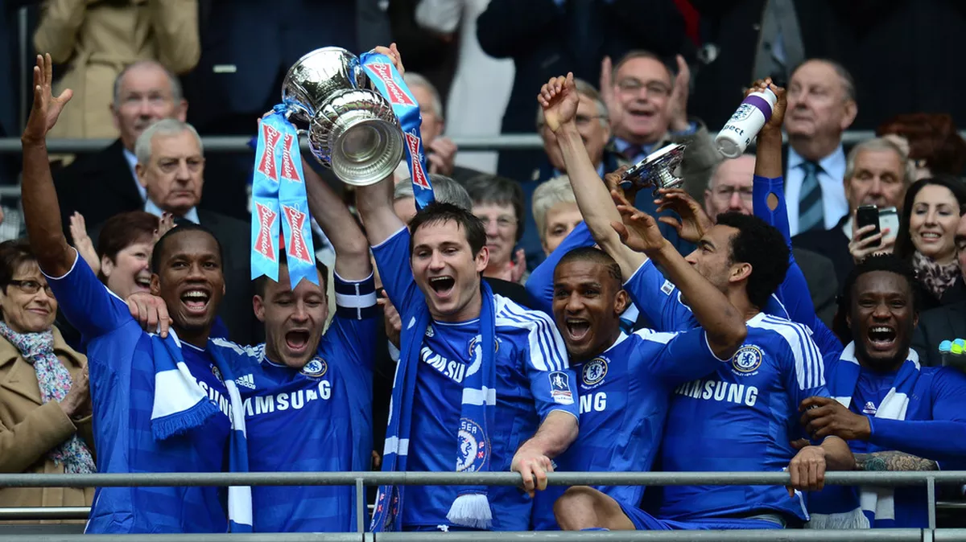
The Power of TV
An analysis of the UK Phenomenon “TV Pickup”
By: Alexis, Badou, Godfrey, Jerry, Lauren, Michael, Pragya, Sancta and Yongzhen

Slide 2
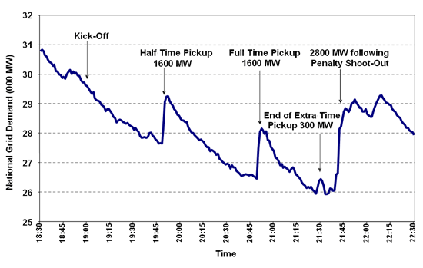
What is TV Pickup?
The sudden surge in demand for electricity which is unique to Britain
Occurs during breaks of popular TV programs or Sports events
Caused by millions of people collectively switching on kettles to make tea, opening the fridge, or flushing the toilets
http://cmuscm.blogspot.com/2014/10/forecasting-tv-pickups-in-britain.html
Notes:
Make sure to take note of how flushing toilets would affect power usage

Slide 3

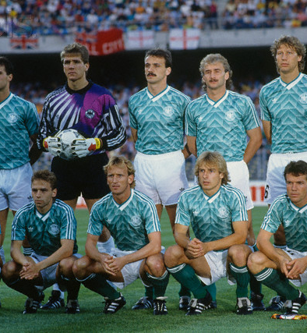
1990 World Cup Semi Final – West Germany vs. England
Power demand: 2800 MW
When England was defeated in a toe-curling penalty shootout, our hearts sunk as we waved goodbye to a tearful Gazza and the gang. Only a nice cup of tea could console the nation. The resulting power surge was the equivalent of 1.12 million kettles being switched on at the same time.
Notes:
https://www.britishgas.co.uk/the-source/our-world-of-energy/surprising-world-of-energy/power-surge

Slide 4

5 April 2001 EastEnders
Power demand: 2290MW
Lisa admits shooting Phil

Slide 5

So what’s the tea?
The real question is, can TV Pickup be detected and, if so, how?

Slide 6



Can We Detect TV Pick Up?
Hypothesis:
Can TV Pick Up be detected for major sports events and popular soap operas?
How do we detect TV Pickup?
We need to look for a spike in power usage
We need to confirm that the pickup is not coming from an “unknown” factor
Notes:
I took out the text below since we already have examples of other pickup phenomenon
Michael mentioned that it would be a good idea to add that we need to see a spike in power usage to determine pickup
Various examples throughout the history
5 April 2001 : EastEnders – Lisa admits shooting Phil 2290MW
21 June 2002 : England Vs Brazil World Cup 2570MW

Slide 7




Detecting TV Pickup: What factors should we consider?
Power Usage
TV Ratings
Detecting Pickup
Spurious Factors
Notes:
Power/Electricity Usage
Analyzing electricity usage at times of major sporting events or soap operas may show a trend for an uptick in energy usage
TV Ratings
Pulling ratings for large sports events/ soap operas may help us to find events with large audience samples to better analyze power usage at that time
Detecting Pickup
We need to look for “spikes” in power usage within specific dates and time frames that correlate with large sports events or soap operas
Spurious Factors
At first glance, TV Pickup was typically accredited to large audiences making kettles of tea, however, there may be other factors to consider such as opening a fridge or flushing a toilet.

Slide 8
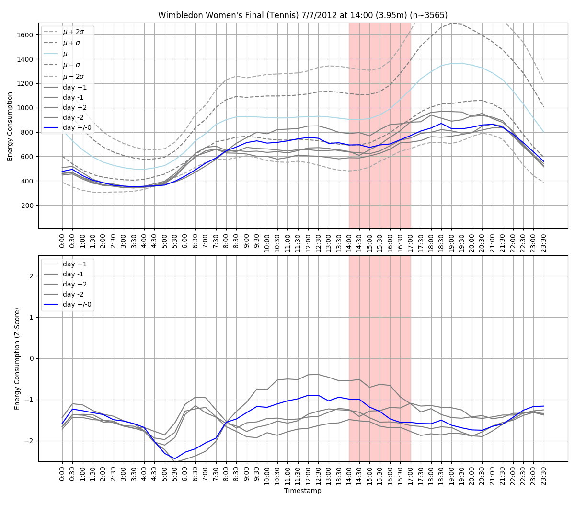
Detecting Pickup Example:

Slide 9
Detecting TV Pickup: What factors should we consider?
Power/Usage
TV Ratings
Detecting Pickup
Spurious Factors
Notes:
Came back to this to talk about spurious factors
Power/Electricity Usage
Analyzing electricity usage at times of major sporting events or soap operas may show a trend for an uptick in energy usage
TV Ratings
Pulling ratings for large sports events/ soap operas may help us to find events with large audience samples to better analyze power usage at that time
Detecting Pickup
We need to look for “spikes” in power usage within specific dates and time frames that correlate with large sports events or soap operas
Spurious Factors
At first glance, TV Pickup was typically accredited to large audiences making kettles of tea, however, there may be other factors to consider such as opening a fridge or flushing a toilet.

Slide 10

Can we break this down even further?

Slide 11
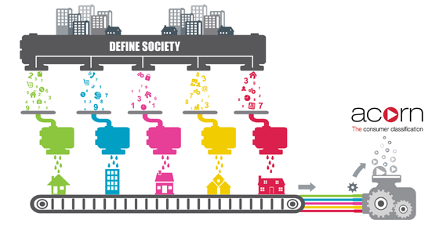
What is Acorn?
A powerful consumer classification
Analyzed using demographic data, social factors, population, and consumer behavior
Affluent Achievers
Rising Prosperity
Comfortable Communities
Financially Stretched
Urban Diversity
Not Private Households

Slide 12
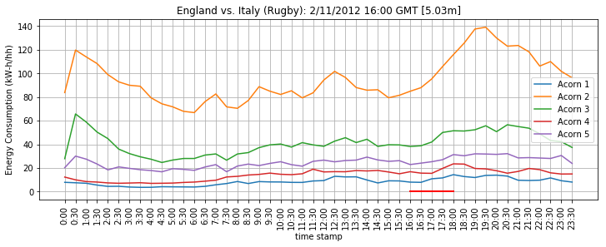
Acorn & TV Pick Up
We looked at these Acorn classifications to see if pickup could be detected in different prosperity groups
The Acorn groups are specified by different colors of lines in the graph

Slide 13

Data Preparation & Processing

Slide 14
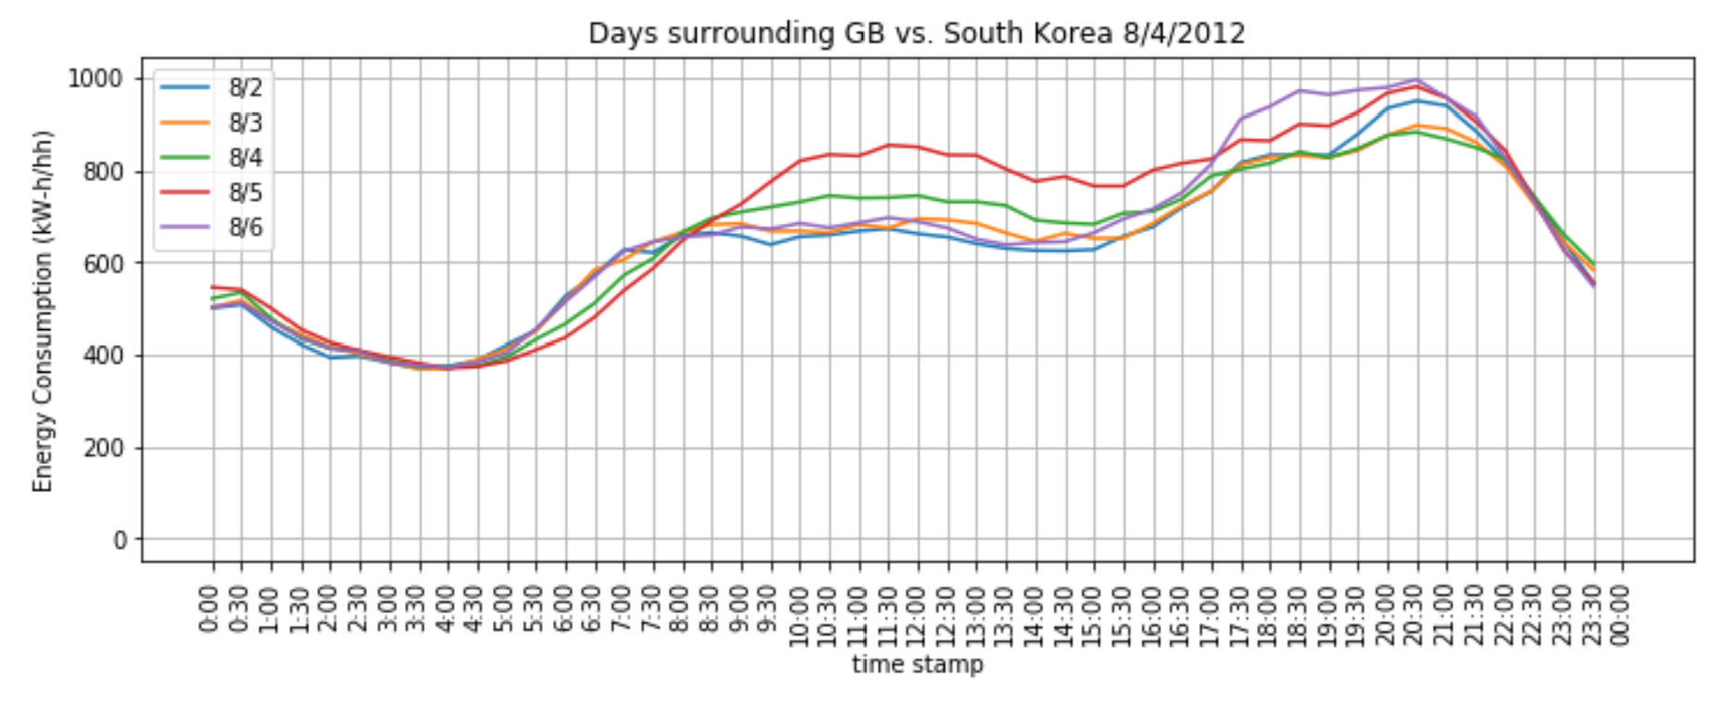
Data Preparation & Processing
MAC000003,Std,2012-02-29 22:30:00.0000000, 0.168 ,ACORN-P,Adversity
MAC000003,Std,2012-02-29 23:00:00.0000000, 0.183 ,ACORN-P,Adversity
MAC000003,Std,2012-02-29 23:30:00.0000000, 0.21 ,ACORN-P,Adversity
MAC000006,Std,2012-02-01 00:00:00.0000000, 0.04 ,ACORN-Q,Adversity
…
…
UK Power Networks
LCL Project
5,567 customers
Energy usage per half-hr.
Measured 2012, 2013
CSV file, 10 GB
167 million rows

Slide 15




Data Preparation Flow
10 GB
CSV
24 ‘raw’
CSV
pandas
24 ‘clean’
CSV
complete
CSV
Separate giant csv file into 24 months.
grep Std,2012-04- 10gb.csv > 2012-04.csv
Create new columns from datetime:
‘year’
‘month’
‘day’
‘hour’
‘minute’
Combine data into one file.
Clean – filter out Null.
groupby(['datetime','acorn’])
For each datetime:
Sum energy over each rec. in Acorn group
Count records in each Acorn group
Total energy and counts over all Acorn Groups

Slide 16
Example:

Slide 17
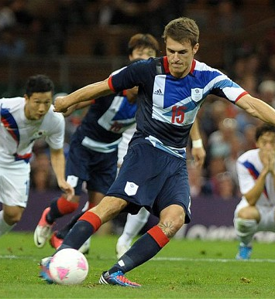
GB V. South Korea August 4th, 2012
The 2012 summer Olympics was an international multi-sport event that was held from July 27th to August 12th in Wales. The GB Vs South Korea Soccer Game began at 19:30 GMT at the Millennium Stadium on Saturday August 4, 2012 and ended with a high audience viewing of 12.4 million.
We chose to focus on highly viewed sports events in the UK to find large impacts on the power of electricity in GB’s household.
Notes:
Badou and Yongzhen

Slide 18
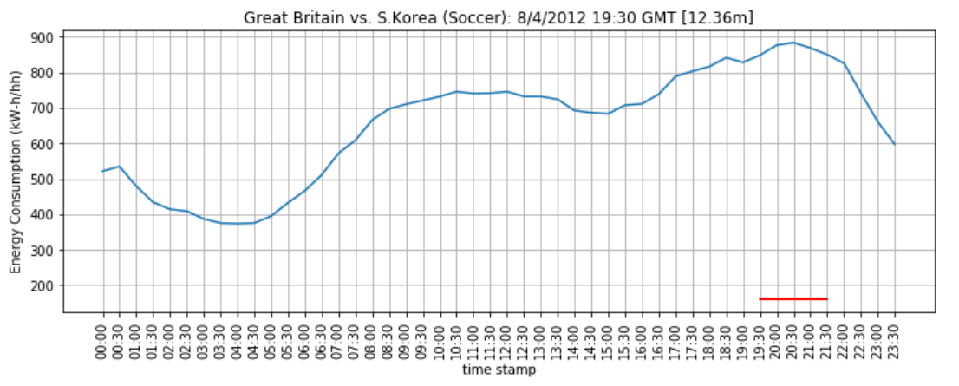
Case study: Energy Consumption during a Soccer Game
Break time
Game time
Energy consumption reached to a peak at game break time.
Notes:
Yongzhen & Badou
This is what we originally thought showed pickup

Slide 19
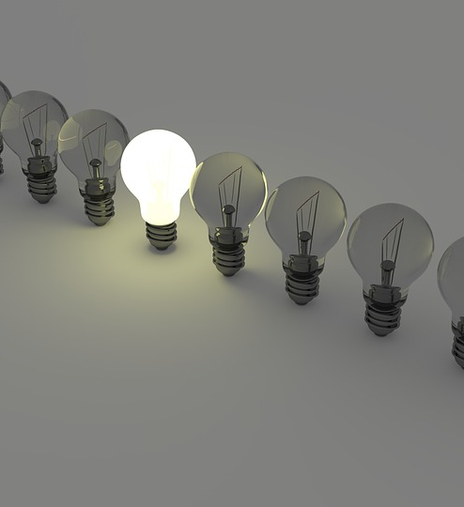
Power consumption during sporting events and soaps
Notes:
Godfrey’s slides
NOTE:
To change the image on this slide, select the picture and delete it. Then click the Pictures icon in the placeholder to insert your own image.

Slide 20
Summary Of Findings
Overall, available data shows significant power usage during sporting events and peaks mostly midway into the game.
Limitations: The factors that are driving the trend are unclear

Slide 21

Soccer

Slide 22
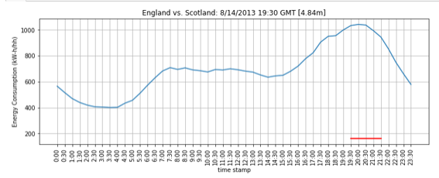
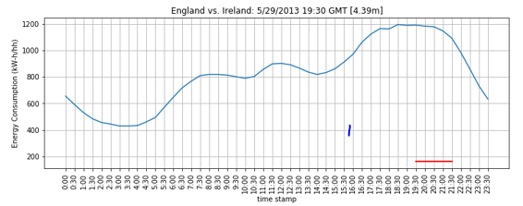
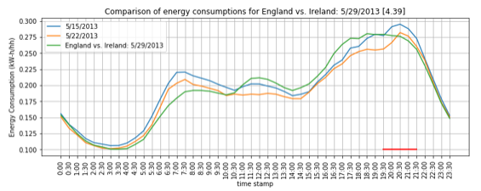

Slide 23
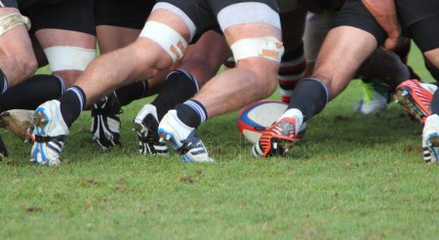
Rugby

Slide 24
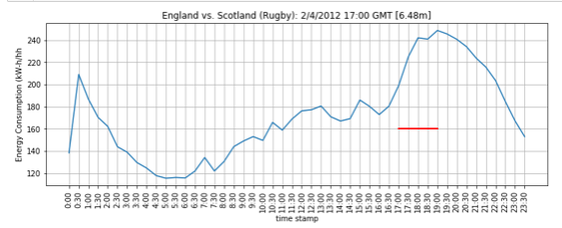
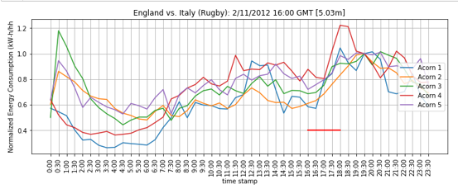

Slide 25

Athletes

Slide 26
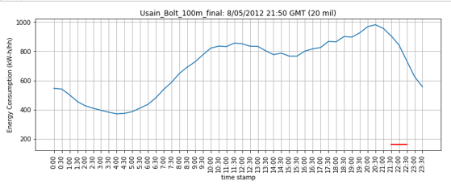
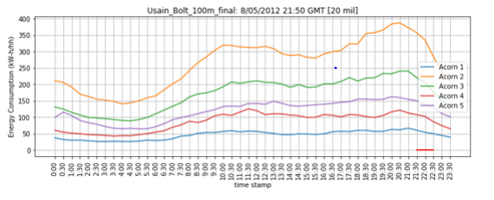

Slide 27

Emmerdale

Slide 28
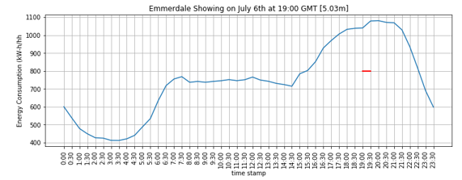
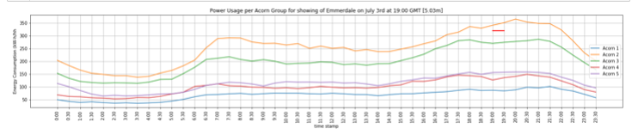
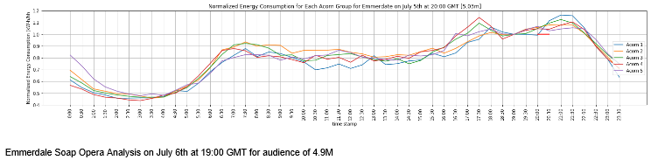

Slide 29
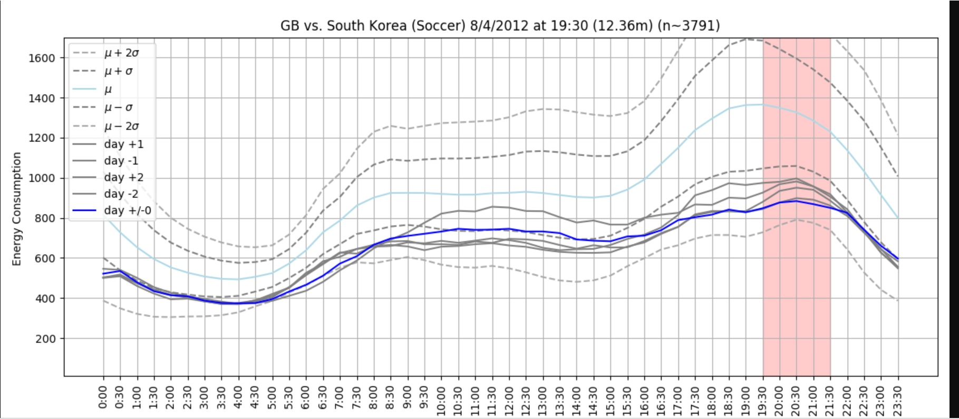
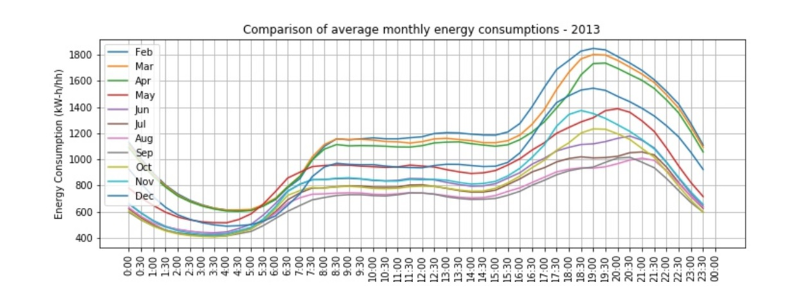

GB vs. South Korea, Olympics 2012
GB vs South Korea is one of the major event which show attracted a big audience in 2012
Thus,
A perfect case study of TV Pickup phenomena

Slide 30
Are Graphs and Anecdotes About Tea Enough?
Notes:
Sancta’s slides should go before this
Michael

Slide 31
Great Britain Vs. South Korea (again)
Seems like the perfect candidate for an observation of ‘pickup’ using our dataset.
About 12.36 million Brits. watched.
Occurred as part of the 2012 London Olympics.
Peak power usage for that entire day coincided exactly with half-time.
To actually provide some substance to the idea that this is an observation of pickup, we should compare that day’s power consumption with neighboring days.

Slide 32
Hmmmmm. It’s the min… ( ͠° ͟ʖ ͡°).

Slide 33
Maybe it’s still larger than most other days at the same time?
(☉ ͜ʖ☉)… That’s gotta be it.

Slide 34
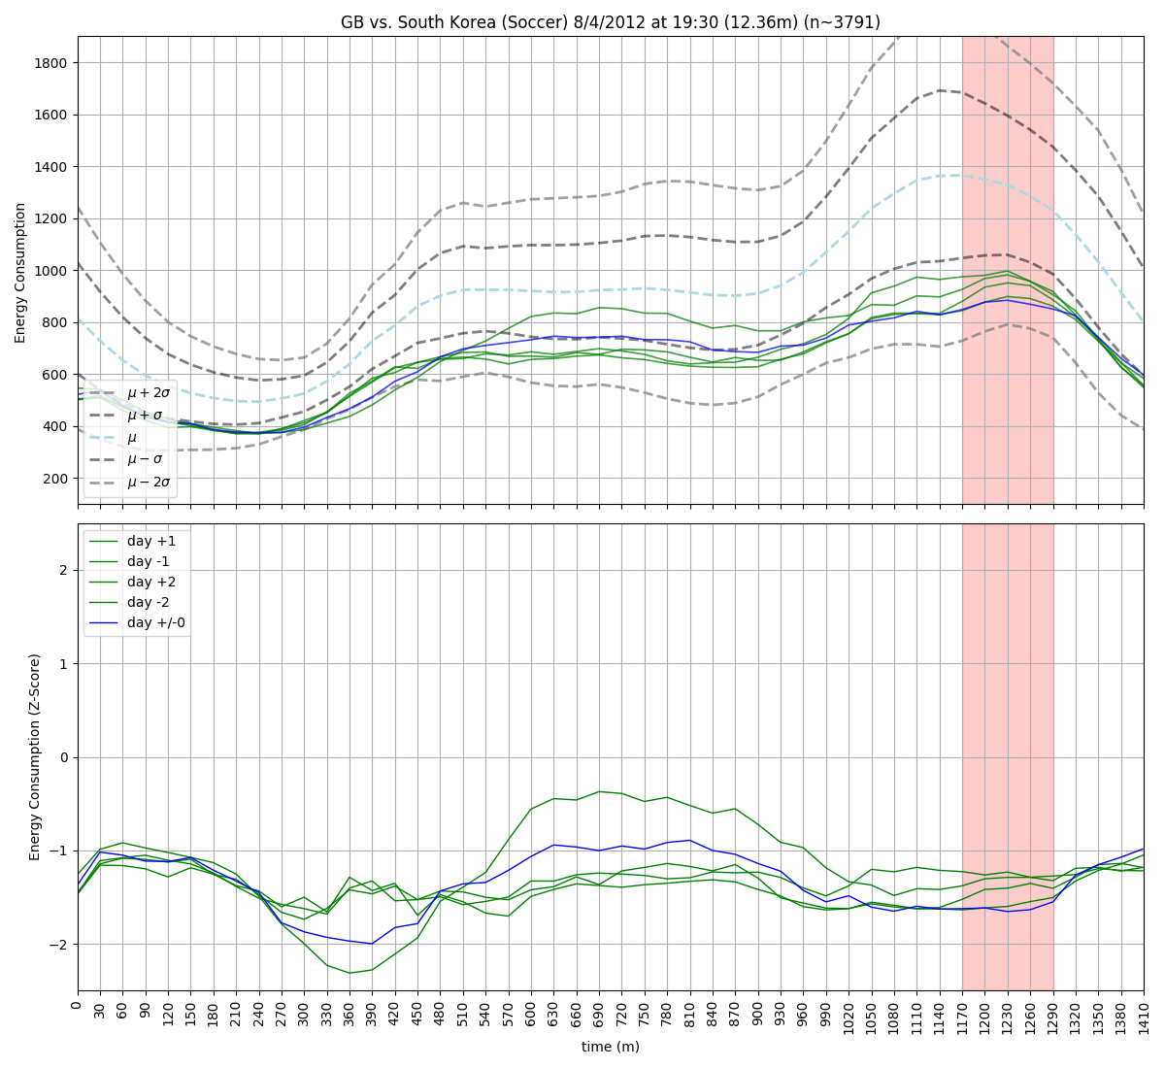
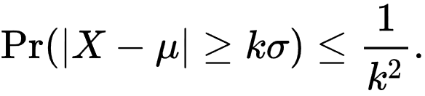
Recall Chebyshev's inequality:
Estimate ‘k’:
it’s bigger than 1.5.
Draw Conclusion:
At least 55% of days have larger power usage during the same time.
ಠ_ಠ
This might require more effort than initially anticipated…
… need to look at more examples

Slide 35
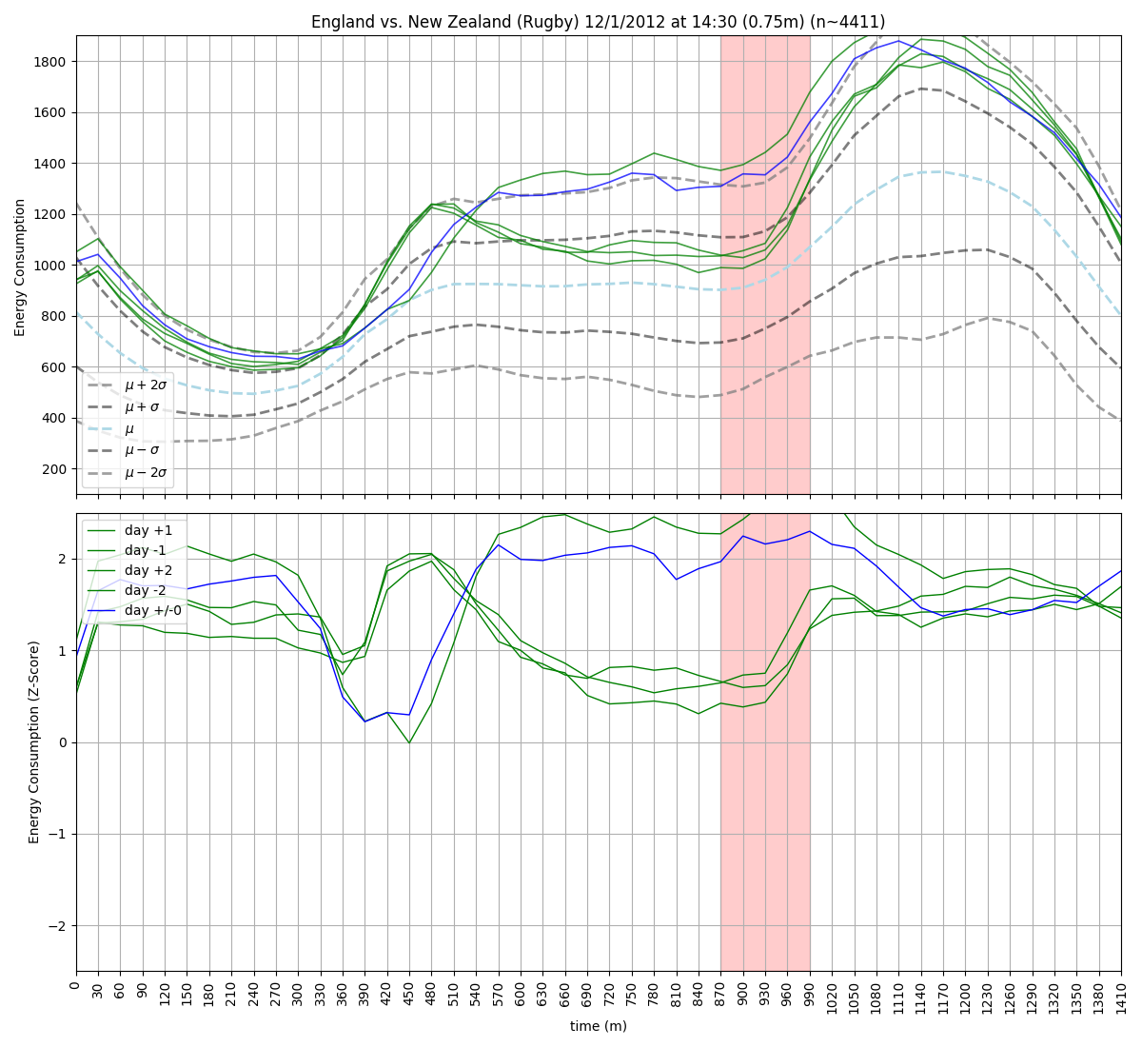
New Sport:
Rugby
Viewership:
< 0.75 million
Power Usage:
Greater than at least %75 of other days at the same time.
ヽ(ಠ▃ಠ)ﾉ the &%@% is this….

Slide 36
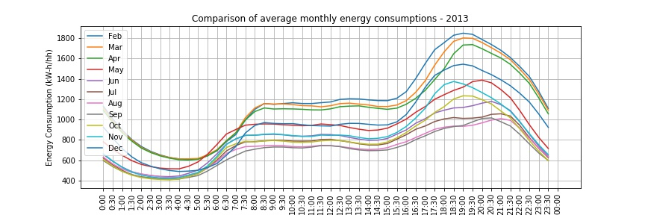

Slide 37
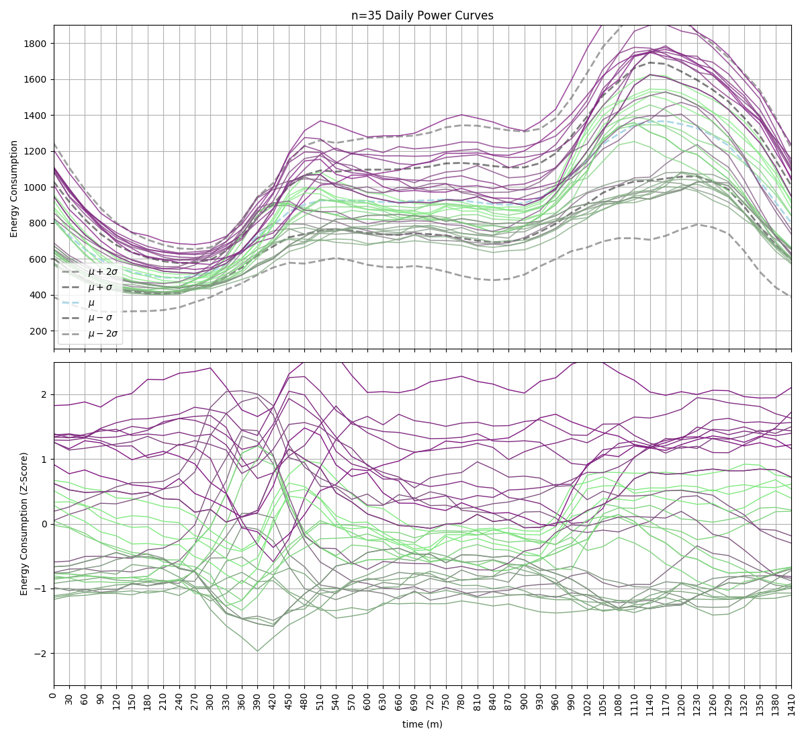
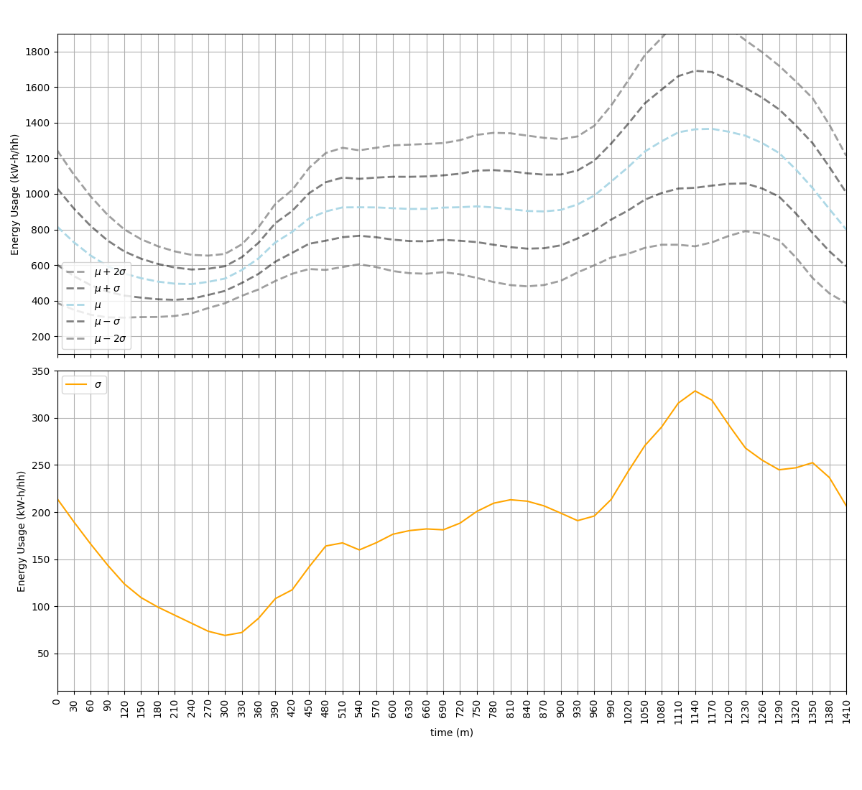
(╭ರ_•́) hmm...
…. more latent conditioning than expected.
ಠل͜ಠ this is going to be fun to screw around with…

Slide 39
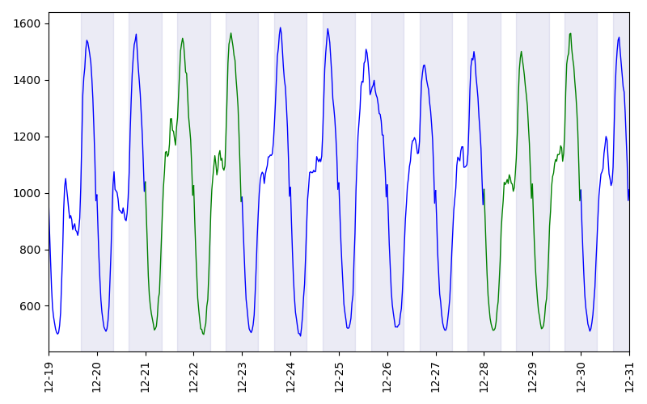
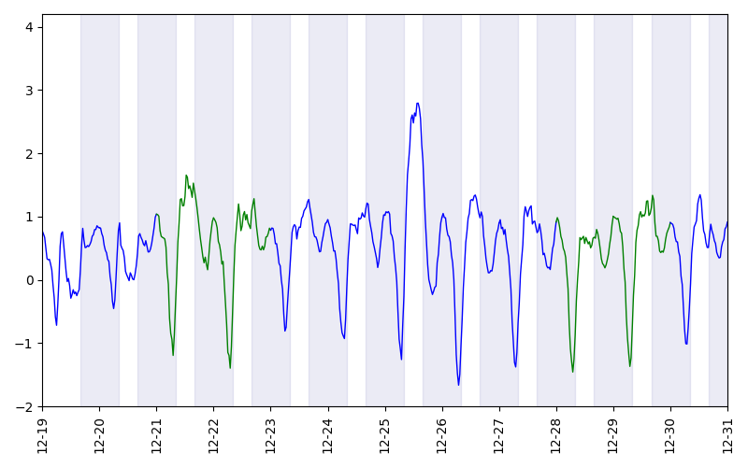
before I get distracted..
Christmas
Raw Signal
Z-Score

Slide 40
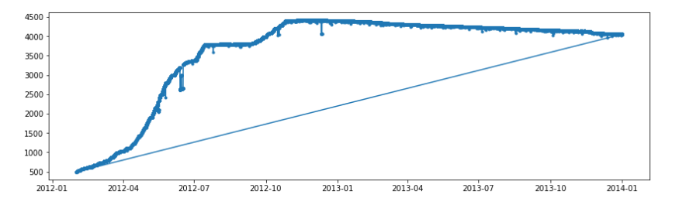
Sample Population Size

Slide 41
Sources
1990 W Germany v. England: https://impromptuinc.wordpress.com/2012/03/31/1990-west-germany-england-1-1-0-0-1-1-4-3/
https://www.britishgas.co.uk/the-source/our-world-of-energy/surprising-world-of-energy/power-surge
https://www.geek.com/geek-cetera/tea-time-in-britain-causes-predictable-massive-surge-in-electricity-demand-1535023/
http://news.bbc.co.uk/2/hi/uk_news/magazine/6981356.stm
https://acorn.caci.co.uk/what-is-acorn
https://www.telegraph.co.uk/news/earth/energy/7819443/National-Grid-anticipates-power-surges-during-World-Cup.html
https://en.wikipedia.org/wiki/EastEnders
http://cmuscm.blogspot.com/2014/10/forecasting-tv-pickups-in-britain.html

